Slide 1
Challenges
Mini challenge 5

Slide 2
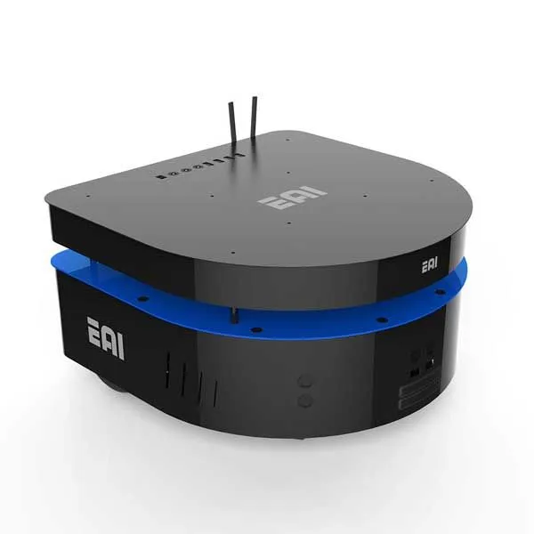
Mini Challenge 5
Introduction
This mini-challenge is intended for the student to review the concepts introduced in the previous sessions.
The robot to be used in the following sessions by the students is the EAI DashGo B1.
The robot contains different sensors and actuators such as LiDARS, Ultrasonic sensors, bumpers, Motors, etc.

Slide 3
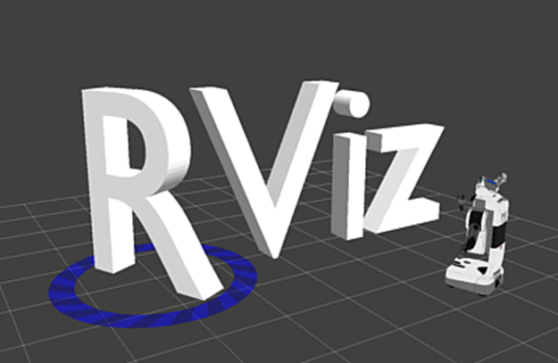
Mini Challenge 3
Introduction
In robotics, the analysis of the behaviour of a robot is usually performed by plotting the states of the robot.
ROS allows us not only to read sensors but also to plot the data provided by such sensors in a more “fashionable” way using the visualisation capabilities of RVIZ.
The activity involves creating a visualisation of the DashGo B1 robot in RVIZ.

Slide 4
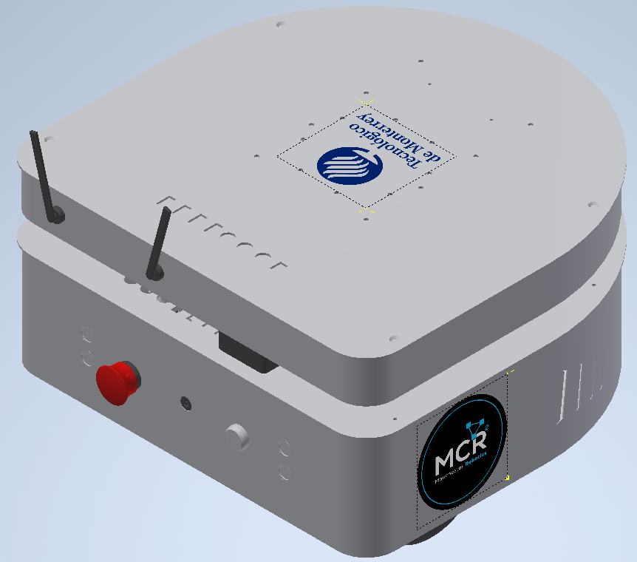
Mini Challenge 5
Challenge
The student must be able to use a URDF file to visualise a robot in RVIZ and make it move using a simple node.
Describe the robot (nonholonomic) in a URDF format, using joints and links.
Use the Provided STL files (STL folder in GitHub) to visualise the meshes of the robot in RVIZ. For reference, the student can use the step file of the robot provided (STP folder in GitHub).

Slide 5
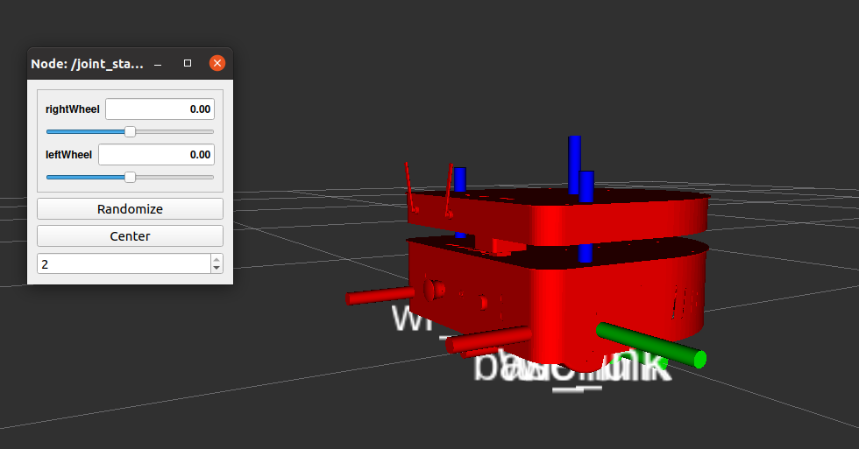
Mini Challenge 5
Challenge
Use the joint state publisher to verify if the links and joints behave properly.
Generate a node to publish data to the joints to simulate a simple trajectory for the robot.

Slide 6
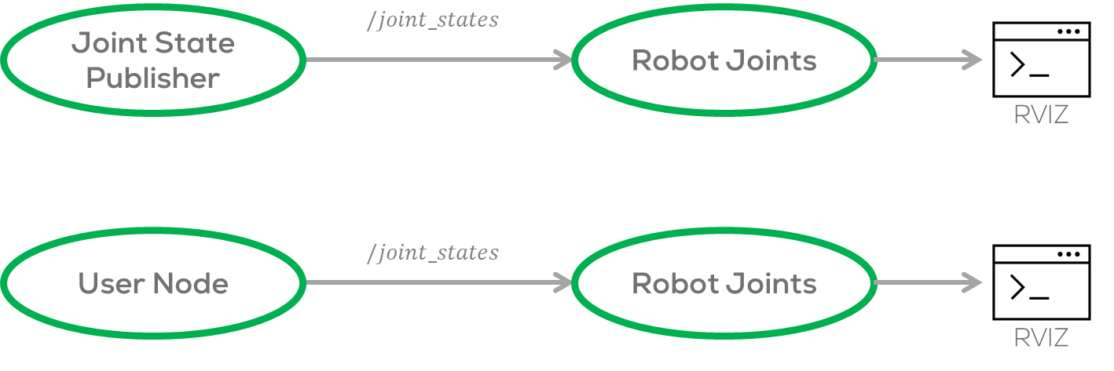
Mini Challenge 3
Hints:
Controlling the joints requires a “JointState” message included in the “sensor_msgs/JointState.” More information here.
Remember to remove the Joint State publisher, once you start publishing data with your node.
Use the Joint state publisher just to test your joints.

Slide 7
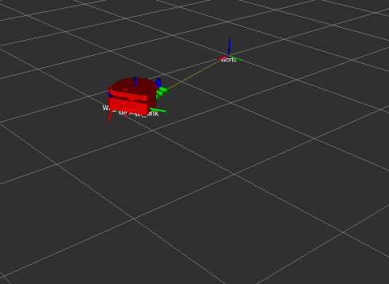
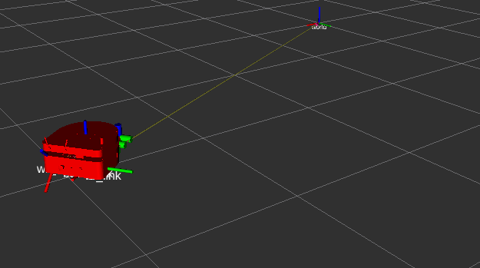
Expected results

Slide 8
Rules
This is challenge, not a class. The students are encouraged to research, improve tune explain their algorithms by themselves.
MCR2(Manchester Robotics) Reserves the right to answer a question if it is determined that the question contains partially or an answer.
The students are welcome to ask only about the theoretical aspect of the class.
No remote control or any other form of human interaction with the simulator or ROS is allowed (except at the start when launching the files).
It is forbidden to use any other internet libraries except for standard libraries such as NumPy.
If in doubt about libraries, please ask any teaching assistant.
Improvements to the algorithms are encouraged and may be used if the students provide the reasons and a detailed explanation of the improvements.
All the students must respect each other and abide by the previously defined rules.
Manchester Robotics reserves the right to provide any form of grading. Grading and grading methodology are done by the professor in charge of the unit.

